Slide 1


Control Flow
Chris Piech
CS106A, Stanford University

Slide 2

CS106A

Slide 3


Karel the Robot
s
* While Karel is in Java, when you program your Karel assignment we ask that you stick to the concepts in the course reader
Notes:
Tomorrow you will learn that Karel is actually a very gentle introduction to programming

Slide 4


First Challenge
3
+
+
+
+
2
+
+
+
+
1
+
+
+
+
1
2
3
4

Slide 5
Anatomy of a Program
import stanford.karel.*;
public class OurKarelProgram extends Karel {
public void run() {
move();
pickBeeper();
move();
turnLeft();
move();
turnRight();
move();
putBeeper();
move();
}
private void turnRight() {
turnLeft();
turnLeft();
turnLeft();
}
}
This is the program's source code

Slide 6
Anatomy of a Program
import stanford.karel.*;
public class OurKarelProgram extends Karel {
public void run() {
move();
pickBeeper();
move();
turnLeft();
move();
turnRight();
move();
putBeeper();
move();
}
private void turnRight() {
turnLeft();
turnLeft();
turnLeft();
}
}
This piece of the program's source code is called a method.

Slide 7
Anatomy of a Program
import stanford.karel.*;
public class OurKarelProgram extends Karel {
public void run() {
move();
pickBeeper();
move();
turnLeft();
move();
turnRight();
move();
putBeeper();
move();
}
private void turnRight() {
turnLeft();
turnLeft();
turnLeft();
}
}
x
This line of code gives the name of the method
(here, run)

Slide 8
Anatomy of a Program
import stanford.karel.*;
public class OurKarelProgram extends Karel {
public void run() {
move();
pickBeeper();
move();
turnLeft();
move();
turnRight();
move();
putBeeper();
move();
}
private void turnRight() {
turnLeft();
turnLeft();
turnLeft();
}
}
This line of code gives the name of the method
(here, turnRight)

Slide 9
Anatomy of a Program
import stanford.karel.*;
public class OurKarelProgram extends Karel {
public void run() {
move();
pickBeeper();
move();
turnLeft();
move();
turnRight();
move();
putBeeper();
move();
}
private void turnRight() {
turnLeft();
turnLeft();
turnLeft();
}
}
This is called an import statement. It tells Java what Karel is.

Slide 10
Anatomy of a Program
import stanford.karel.*;
public class OurKarelProgram extends Karel {
public void run() {
move();
pickBeeper();
move();
turnLeft();
move();
turnRight();
move();
putBeeper();
move();
}
private void turnRight() {
turnLeft();
turnLeft();
turnLeft();
}
}
This is called a code block

Slide 11
Anatomy of a Program
import stanford.karel.*;
public class OurKarelProgram extends Karel {
public void run() {
move();
pickBeeper();
move();
turnLeft();
move();
turnRight();
move();
putBeeper();
move();
}
private void turnRight() {
turnLeft();
turnLeft();
turnLeft();
}
}

Slide 12
Anatomy of a Program
import stanford.karel.*;
public class OurKarelProgram extends Karel {
public void run() {
move();
pickBeeper();
move();
turnLeft();
move();
turnRight();
move();
putBeeper();
move();
}
private void turnRight() {
turnLeft();
turnLeft();
turnLeft();
}
}

Slide 13
Anatomy of a Program
import stanford.karel.*;
public class OurKarelProgram extends Karel {
public void run() {
move();
pickBeeper();
move();
turnLeft();
move();
turnRight();
move();
putBeeper();
move();
}
private void turnRight() {
turnLeft();
turnLeft();
turnLeft();
}
}

Slide 14
Anatomy of a Program
import stanford.karel.*;
public class OurKarelProgram extends Karel {
public void run() {
move();
pickBeeper();
move();
turnLeft();
move();
turnRight();
move();
putBeeper();
move();
}
private void turnRight() {
turnLeft();
turnLeft();
turnLeft();
}
}

Slide 15
Anatomy of a Program
import stanford.karel.*;
public class OurKarelProgram extends Karel {
public void run() {
move();
pickBeeper();
move();
turnLeft();
move();
turnRight();
move();
putBeeper();
move();
}
private void turnRight() {
turnLeft();
turnLeft();
turnLeft();
}
}
The run method is “public” so that Eclipse can call it.

Slide 16
Anatomy of a Program
import stanford.karel.*;
public class OurKarelProgram extends Karel {
public void run() {
move();
pickBeeper();
move();
turnLeft();
move();
turnRight();
move();
putBeeper();
move();
}
private void turnRight() {
turnLeft();
turnLeft();
turnLeft();
}
}
The turnRight method is “private” to indicate it is only visible to our current program.

Slide 17
Method Definition
private void name() {
statements in the method body
}
This adds a new command to Karels vocabulary

Slide 18
More complex programs.

Slide 19
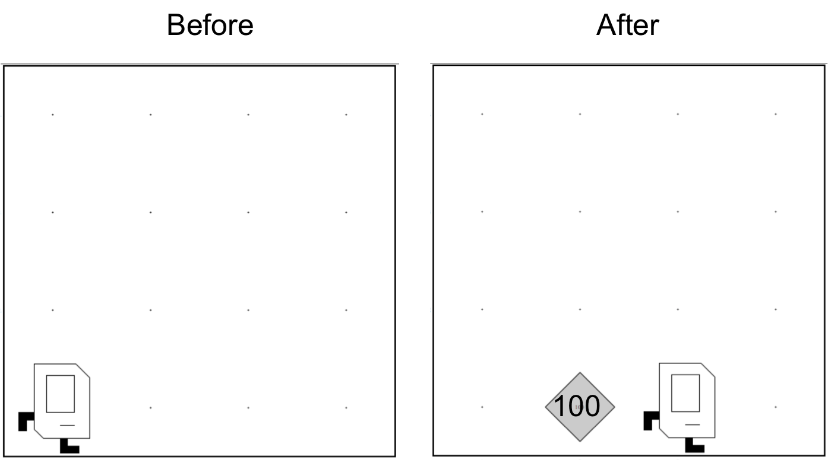
Place 99 beepers?
99

Slide 20
Place 99 beepers
public class Place99Beepers extends SuperKarel {
public void run() {
move();
for(int i = 0; i < 99; i++) {
putBeeper();
}
move();
}
}
This “for loop” repeats the code in its “body” 99 times

Slide 21

Place Beeper Square
public class BeeperSquare extends SuperKarel {
public void run() {
for(int i = 0; i < 4; i++) {
putBeeper();
move();
turnLeft();
}
}
}

Slide 22
Place Beeper Square
public class BeeperSquare extends SuperKarel {
public void run() {
for(int i = 0; i < 4; i++) {
putBeeper();
move();
turnLeft();
}
}
}
First time through the loop

Slide 23

Place Beeper Square
public class BeeperSquare extends SuperKarel {
public void run() {
for(int i = 0; i < 4; i++) {
putBeeper();
move();
turnLeft();
}
}
}
First time through the loop

Slide 24
Place Beeper Square
public class BeeperSquare extends SuperKarel {
public void run() {
for(int i = 0; i < 4; i++) {
putBeeper();
move();
turnLeft();
}
}
}
First time through the loop

Slide 25
Place Beeper Square
public class BeeperSquare extends SuperKarel {
public void run() {
for(int i = 0; i < 4; i++) {
putBeeper();
move();
turnLeft();
}
}
}
First time through the loop

Slide 26
Place Beeper Square
public class BeeperSquare extends SuperKarel {
public void run() {
for(int i = 0; i < 4; i++) {
putBeeper();
move();
turnLeft();
}
}
}
Second time through the loop

Slide 27
Place Beeper Square
public class BeeperSquare extends SuperKarel {
public void run() {
for(int i = 0; i < 4; i++) {
putBeeper();
move();
turnLeft();
}
}
}
Second time through the loop

Slide 28
Place Beeper Square
public class BeeperSquare extends SuperKarel {
public void run() {
for(int i = 0; i < 4; i++) {
putBeeper();
move();
turnLeft();
}
}
}
Second time through the loop

Slide 29
Place Beeper Square
public class BeeperSquare extends SuperKarel {
public void run() {
for(int i = 0; i < 4; i++) {
putBeeper();
move();
turnLeft();
}
}
}
Second time through the loop

Slide 30
Place Beeper Square
public class BeeperSquare extends SuperKarel {
public void run() {
for(int i = 0; i < 4; i++) {
putBeeper();
move();
turnLeft();
}
}
}
Third time through the loop

Slide 31
Place Beeper Square
public class BeeperSquare extends SuperKarel {
public void run() {
for(int i = 0; i < 4; i++) {
putBeeper();
move();
turnLeft();
}
}
}
Third time through the loop

Slide 32
Place Beeper Square
public class BeeperSquare extends SuperKarel {
public void run() {
for(int i = 0; i < 4; i++) {
putBeeper();
move();
turnLeft();
}
}
}
Third time through the loop

Slide 33
Place Beeper Square
public class BeeperSquare extends SuperKarel {
public void run() {
for(int i = 0; i < 4; i++) {
putBeeper();
move();
turnLeft();
}
}
}
Third time through the loop

Slide 34
Place Beeper Square
public class BeeperSquare extends SuperKarel {
public void run() {
for(int i = 0; i < 4; i++) {
putBeeper();
move();
turnLeft();
}
}
}
Fourth time through the loop

Slide 35
Place Beeper Square
public class BeeperSquare extends SuperKarel {
public void run() {
for(int i = 0; i < 4; i++) {
putBeeper();
move();
turnLeft();
}
}
}
Fourth time through the loop

Slide 36
Place Beeper Square
public class BeeperSquare extends SuperKarel {
public void run() {
for(int i = 0; i < 4; i++) {
putBeeper();
move();
turnLeft();
}
}
}
Fourth time through the loop

Slide 37
Place Beeper Square
public class BeeperSquare extends SuperKarel {
public void run() {
for(int i = 0; i < 4; i++) {
putBeeper();
move();
turnLeft();
}
}
}
Fourth time through the loop

Slide 38
Place Beeper Square
public class BeeperSquare extends SuperKarel {
public void run() {
for(int i = 0; i < 4; i++) {
putBeeper();
move();
turnLeft();
}
}
}

Slide 39
Exciting!

Slide 40

Aside: Super Karel
import stanford.karel.*;
public class BeeperLine extends SuperKarel {
public void run() {
// super karel has a few more commands
turnRight();
turnAround();
paintCorner(BLUE);
putBeeper();
move();
}
}

Slide 41
Next task

Slide 42
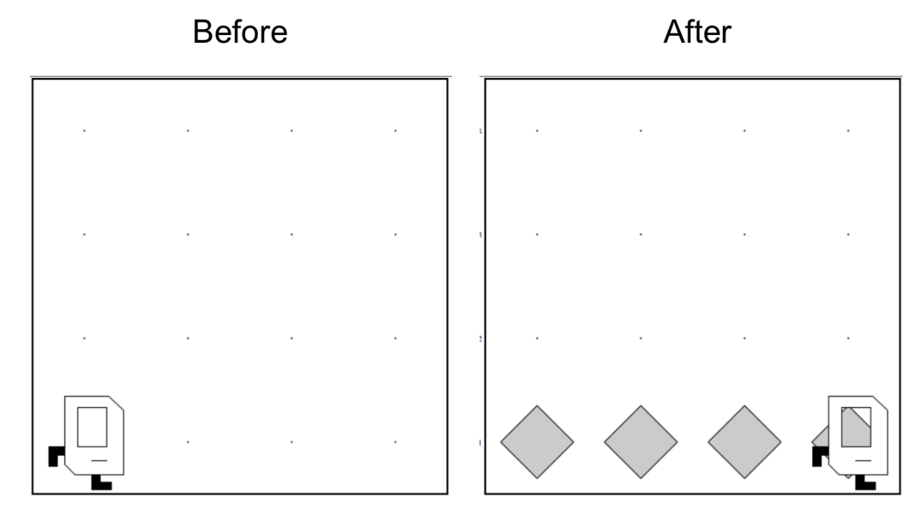
Place Beeper Line

Slide 43
Place Beeper Line
import stanford.karel.*;
public class BeeperLine extends SuperKarel {
public void run() {
for(int i = 0; i < 4; i++) {
putBeeper();
move();
}
}
}

Slide 44


Slide 45

Place Beeper Line
import stanford.karel.*;
public class BeeperLine extends SuperKarel {
public void run() {
for(int i = 0; i < 4; i++) {
putBeeper();
move();
}
}
}

Slide 46


Slide 47

Place Beeper Line
import stanford.karel.*;
public class BeeperLine extends SuperKarel {
public void run() {
for(int i = 0; i < 4; i++) {
putBeeper();
move();
}
}
}
What we want

Slide 48
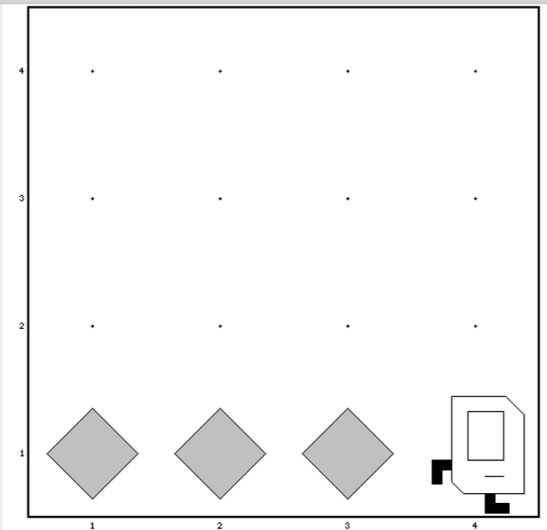
Place Beeper Line
import stanford.karel.*;
public class BeeperLine extends SuperKarel {
public void run() {
for(int i = 0; i < 3; i++) {
putBeeper();
move();
}
}
}

Slide 49

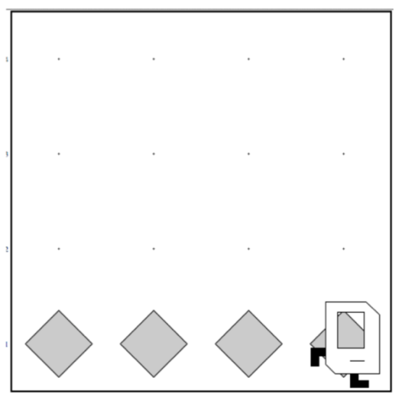
Place Beeper Line
import stanford.karel.*;
public class BeeperLine extends SuperKarel {
public void run() {
for(int i = 0; i < 3; i++) {
putBeeper();
move();
}
// extra put beeper
putBeeper();
}
}

Slide 50
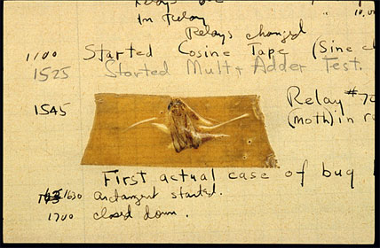
Actual Bug from Mark II Computer
Actual Bug from Marc II

Slide 51
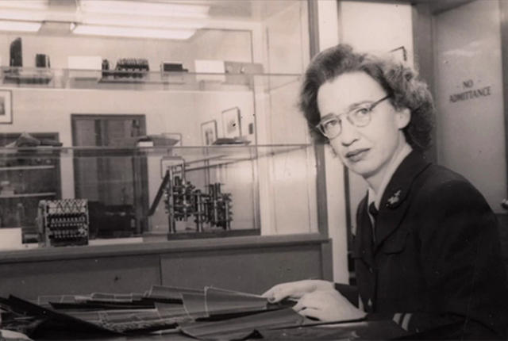
Grace Hopper

Slide 52
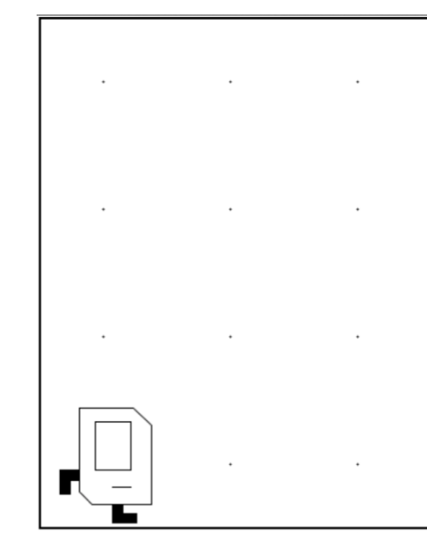
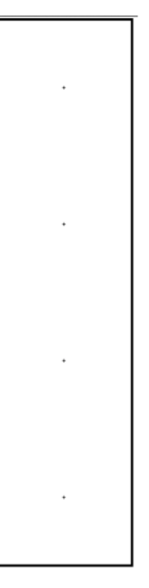
Don’t Know World Size
?

Slide 53
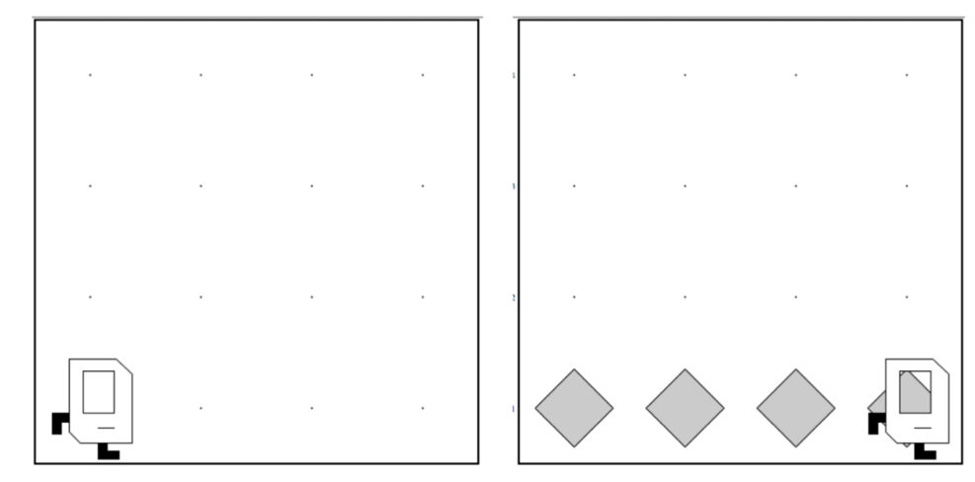
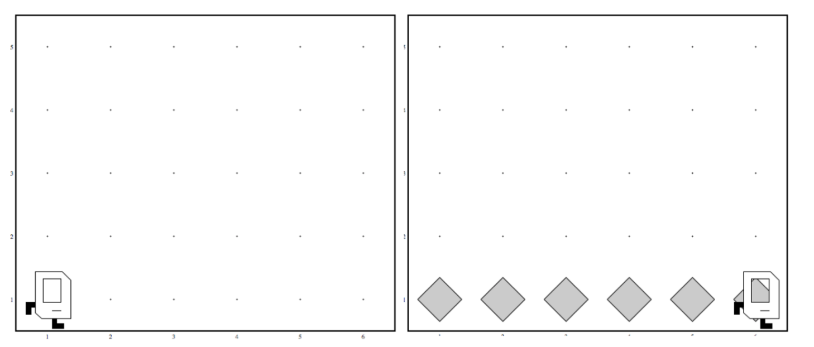
Work in Any World
Before
After
Before
After

Slide 54
While Loop

Slide 55
While Loop
import stanford.karel.*;
public class BeeperLine extends SuperKarel {
public void run() {
// example while loop
while(condition) {
code to repeat
}
}
}

Slide 56
Place Beeper Line
import stanford.karel.*;
public class BeeperLine extends SuperKarel {
public void run() {
// example while loop
while(frontIsClear()) {
move();
}
// extra put beeper
putBeeper();
}
}

Slide 57
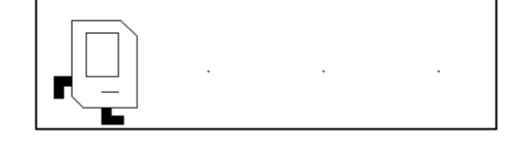
Place Beeper Line
import stanford.karel.*;
public class BeeperLine extends SuperKarel {
public void run() {
// example while loop
while(frontIsClear()) {
putBeeper();
move();
}
// extra put beeper
putBeeper();
}
}

Slide 58
Place Beeper Line
import stanford.karel.*;
public class BeeperLine extends SuperKarel {
public void run() {
// example while loop
while(frontIsClear()) {
putBeeper();
move();
}
// extra put beeper
putBeeper();
}
}

Slide 59
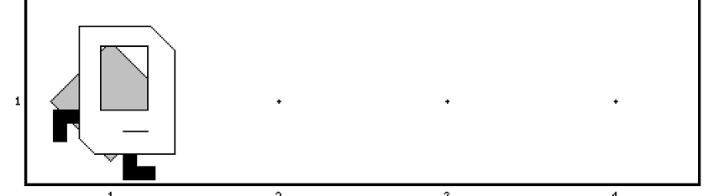
Place Beeper Line
import stanford.karel.*;
public class BeeperLine extends SuperKarel {
public void run() {
// example while loop
while(frontIsClear()) {
putBeeper();
move();
}
// extra put beeper
putBeeper();
}
}

Slide 60
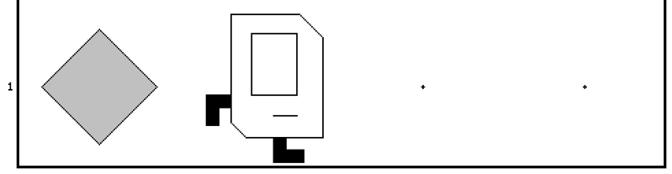
Place Beeper Line
import stanford.karel.*;
public class BeeperLine extends SuperKarel {
public void run() {
// example while loop
while(frontIsClear()) {
putBeeper();
move();
}
// extra put beeper
putBeeper();
}
}

Slide 61
Place Beeper Line
import stanford.karel.*;
public class BeeperLine extends SuperKarel {
public void run() {
// example while loop
while(frontIsClear()) {
putBeeper();
move();
}
// extra put beeper
putBeeper();
}
}

Slide 62
Place Beeper Line
import stanford.karel.*;
public class BeeperLine extends SuperKarel {
public void run() {
// example while loop
while(frontIsClear()) {
putBeeper();
move();
}
// extra put beeper
putBeeper();
}
}

Slide 63
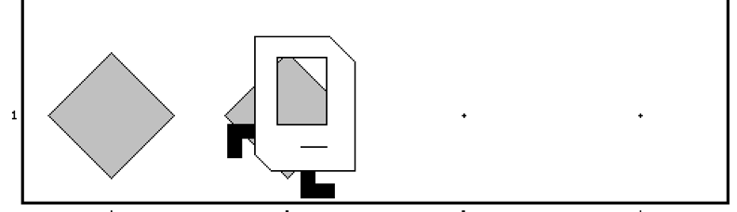
Place Beeper Line
import stanford.karel.*;
public class BeeperLine extends SuperKarel {
public void run() {
// example while loop
while(frontIsClear()) {
putBeeper();
move();
}
// extra put beeper
putBeeper();
}
}

Slide 64
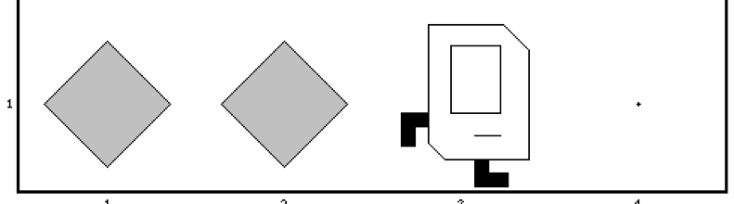
Place Beeper Line
import stanford.karel.*;
public class BeeperLine extends SuperKarel {
public void run() {
// example while loop
while(frontIsClear()) {
putBeeper();
move();
}
// extra put beeper
putBeeper();
}
}

Slide 65
Place Beeper Line
import stanford.karel.*;
public class BeeperLine extends SuperKarel {
public void run() {
// example while loop
while(frontIsClear()) {
putBeeper();
move();
}
// extra put beeper
putBeeper();
}
}

Slide 66
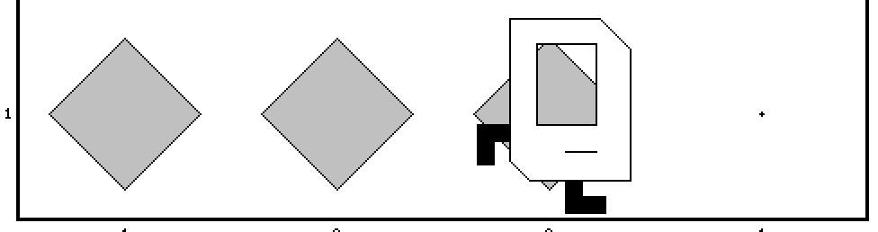
Place Beeper Line
import stanford.karel.*;
public class BeeperLine extends SuperKarel {
public void run() {
// example while loop
while(frontIsClear()) {
putBeeper();
move();
}
// extra put beeper
putBeeper();
}
}

Slide 67
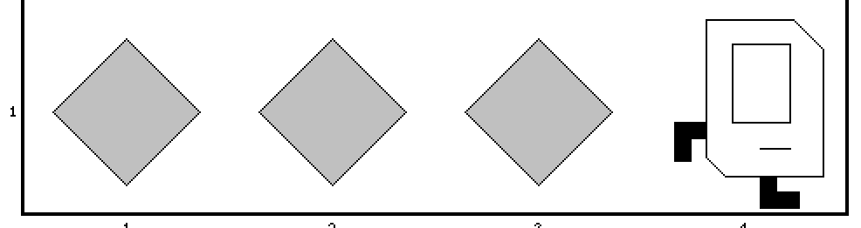
Place Beeper Line
import stanford.karel.*;
public class BeeperLine extends SuperKarel {
public void run() {
// example while loop
while(frontIsClear()) {
putBeeper();
move();
}
// extra put beeper
putBeeper();
}
}

Slide 68
Place Beeper Line
import stanford.karel.*;
public class BeeperLine extends SuperKarel {
public void run() {
// example while loop
while(frontIsClear()) {
putBeeper();
move();
}
// extra put beeper
putBeeper();
}
}

Slide 69
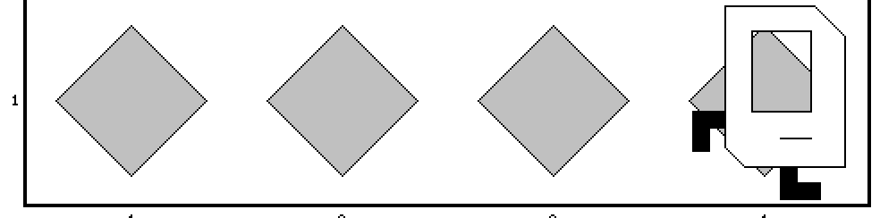
Place Beeper Line
import stanford.karel.*;
public class BeeperLine extends SuperKarel {
public void run() {
// example while loop
while(frontIsClear()) {
putBeeper();
move();
}
// extra put beeper
putBeeper();
}
}

Slide 71
Common misconception:

Slide 72
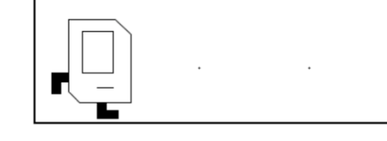
Place Beeper Line: Redux
import stanford.karel.*;
public class BeeperLine extends SuperKarel {
public void run() {
// place a first beeper
putBeeper();
// example while loop
while(frontIsClear()) {
move();
putBeeper();
}
}
}

Slide 73
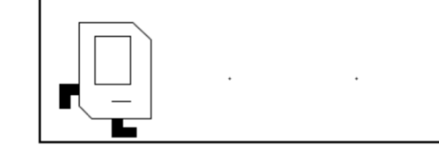
Place Beeper Line: Redux
import stanford.karel.*;
public class BeeperLine extends SuperKarel {
public void run() {
// place a first beeper
putBeeper();
// example while loop
while(frontIsClear()) {
move();
putBeeper();
}
}
}

Slide 74
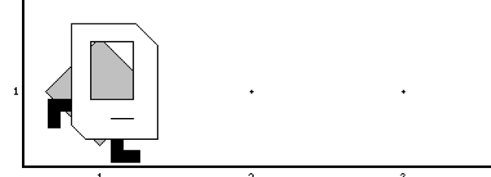
Place Beeper Line: Redux
import stanford.karel.*;
public class BeeperLine extends SuperKarel {
public void run() {
// place a first beeper
putBeeper();
// example while loop
while(frontIsClear()) {
move();
putBeeper();
}
}
}

Slide 75
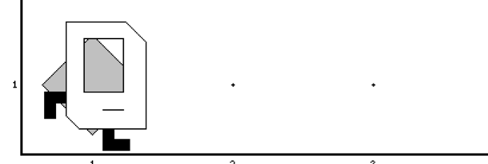
Place Beeper Line: Redux
import stanford.karel.*;
public class BeeperLine extends SuperKarel {
public void run() {
// place a first beeper
putBeeper();
// example while loop
while(frontIsClear()) {
move();
putBeeper();
}
}
}

Slide 76
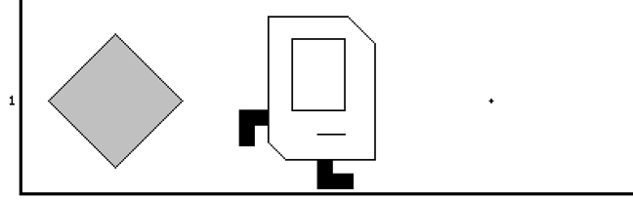
Place Beeper Line: Redux
import stanford.karel.*;
public class BeeperLine extends SuperKarel {
public void run() {
// place a first beeper
putBeeper();
// example while loop
while(frontIsClear()) {
move();
putBeeper();
}
}
}

Slide 77
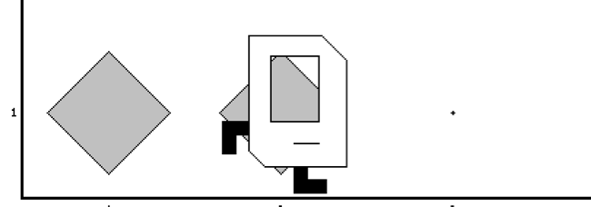
Place Beeper Line: Redux
import stanford.karel.*;
public class BeeperLine extends SuperKarel {
public void run() {
// place a first beeper
putBeeper();
// example while loop
while(frontIsClear()) {
move();
putBeeper();
}
}
}

Slide 78
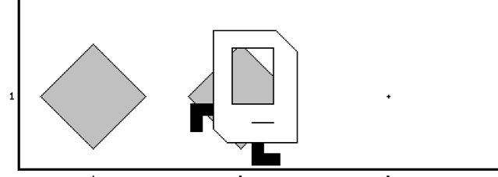
Place Beeper Line: Redux
import stanford.karel.*;
public class BeeperLine extends SuperKarel {
public void run() {
// place a first beeper
putBeeper();
// example while loop
while(frontIsClear()) {
move();
putBeeper();
}
}
}

Slide 79
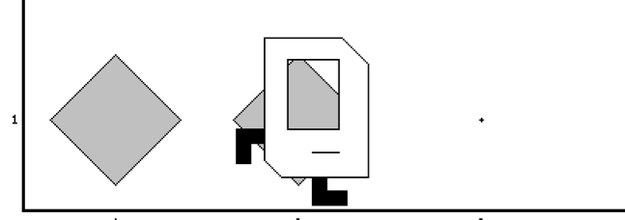
Place Beeper Line: Redux
import stanford.karel.*;
public class BeeperLine extends SuperKarel {
public void run() {
// place a first beeper
putBeeper();
// example while loop
while(frontIsClear()) {
move();
putBeeper();
}
}
}

Slide 80
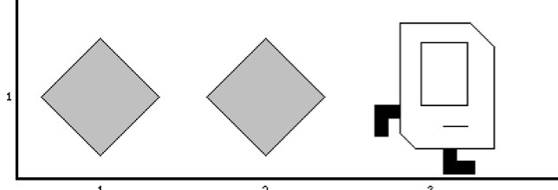
Place Beeper Line: Redux
import stanford.karel.*;
public class BeeperLine extends SuperKarel {
public void run() {
// place a first beeper
putBeeper();
// example while loop
while(frontIsClear()) {
move();
putBeeper();
}
}
}
This is incredibly important!

Slide 81
Place Beeper Line: Redux
import stanford.karel.*;
public class BeeperLine extends SuperKarel {
public void run() {
// place a first beeper
putBeeper();
// example while loop
while(frontIsClear()) {
move();
putBeeper();
}
}
}

Slide 82
Place Beeper Line: Redux
import stanford.karel.*;
public class BeeperLine extends SuperKarel {
public void run() {
// place a first beeper
putBeeper();
// example while loop
while(frontIsClear()) {
move();
putBeeper();
}
}
}

Slide 83
Place Beeper Line: Redux
import stanford.karel.*;
public class BeeperLine extends SuperKarel {
public void run() {
// place a first beeper
putBeeper();
// example while loop
while(frontIsClear()) {
move();
putBeeper();
}
}
}

Slide 84
Place Beeper Line: Redux
import stanford.karel.*;
public class BeeperLine extends SuperKarel {
public void run() {
// place a first beeper
putBeeper();
// example while loop
while(frontIsClear()) {
move();
putBeeper();
}
}
}

Slide 85
Which Loop
Repeat Process
Know how many times
Don’t know how many times
For Loop
While Loop

Slide 86
What if you only want to repeat one time?

Slide 87
If statement

Slide 88
If Statement
import stanford.karel.*;
public class IfExample extends SuperKarel {
public void run() {
// example of an if statement
if(condition) {
code to run if condition is true
}
}
}

Slide 89
If Statement
import stanford.karel.*;
public class IfExample extends Pretend{
public void run() {
// example of an if statement
if(youLikeBeyonce()) {
makeSomeNoise();
}
}
}

Slide 90
If Statement
import stanford.karel.*;
public class IfExample extends SuperKarel{
public void run() {
safeMove();
}
private void safeMove() {
if(frontIsClear()) {
move();
}
}
}

Slide 91
If / Else Statement
import stanford.karel.*;
public class IfExample extends SuperKarel{
public void run() {
invertBeeper();
}
private void invertBeeper() {
if(beeperPresent()) {
pickBeeper();
} else {
putBeeper();
}
}
}

Slide 92
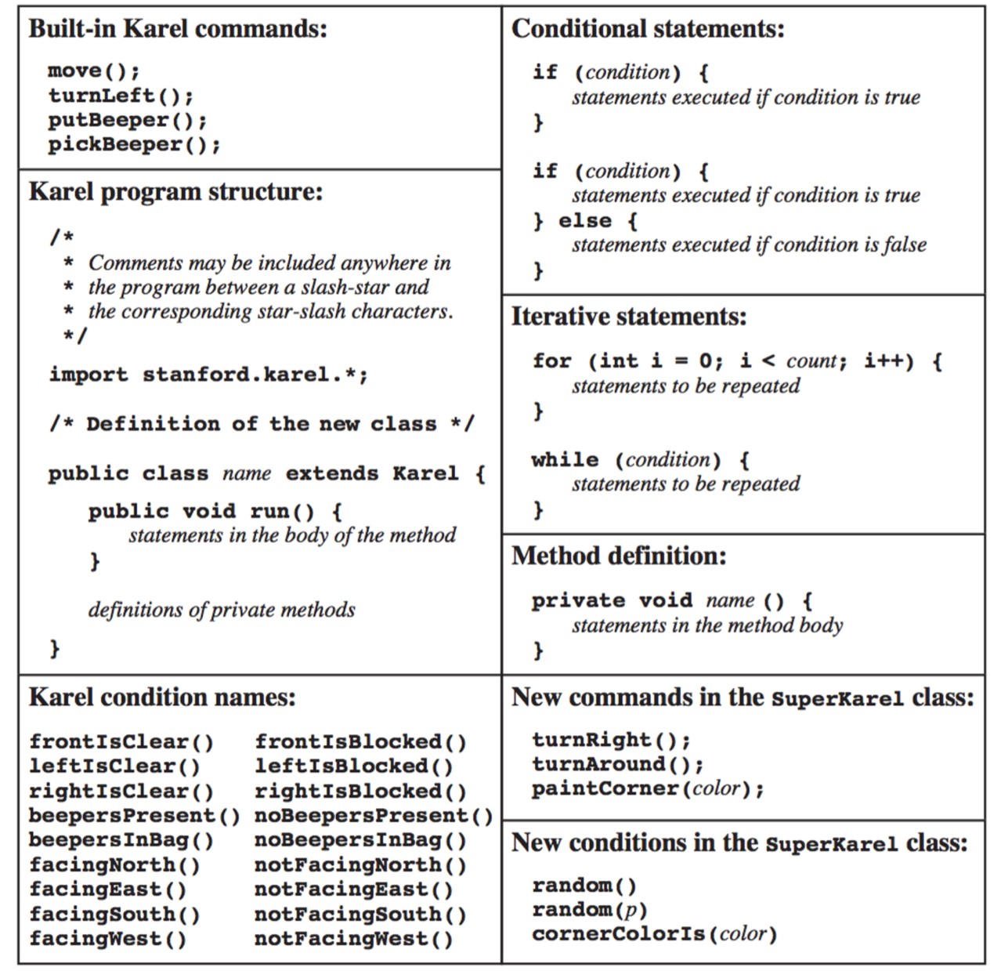
The Full Karel

Slide 93
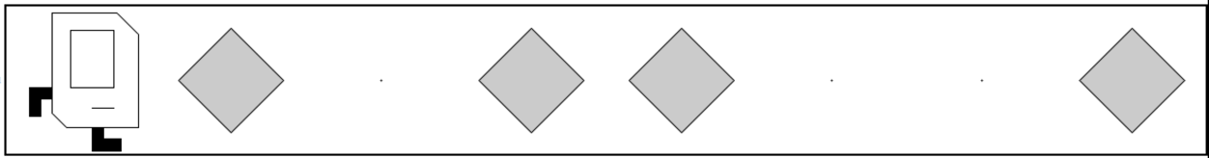
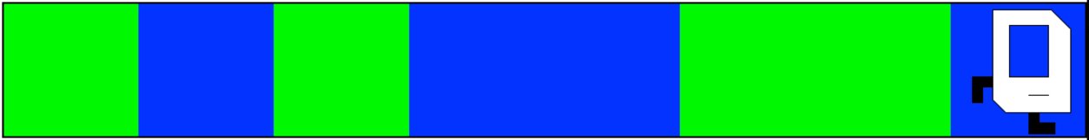
Random Painter
Before:
After:
Before:
After:

Slide 94
You just learned most of programming “control flow”

